Slide 1




STUDENT MANGMENT SYSTEM

Slide 2

23-101054
22-101233
Eyad Ehab
Youssef Osama
23-101235
23-101159
Yassin Hany
Ali Amin
23-101005
Ahmed Ehab

Slide 3
PROJECT INTRODUCTION
We developed an application where users can sign in, create an account, and choose their role: student, instructor, or administrator. Students can manage courses and view grades, instructors can update grades and courses, and administrators can oversee both. This system makes managing education simple and easy.

Slide 4

GITHUB
We used github for better team collaboration and so we can upload it to our CV’s in the future.

Slide 5
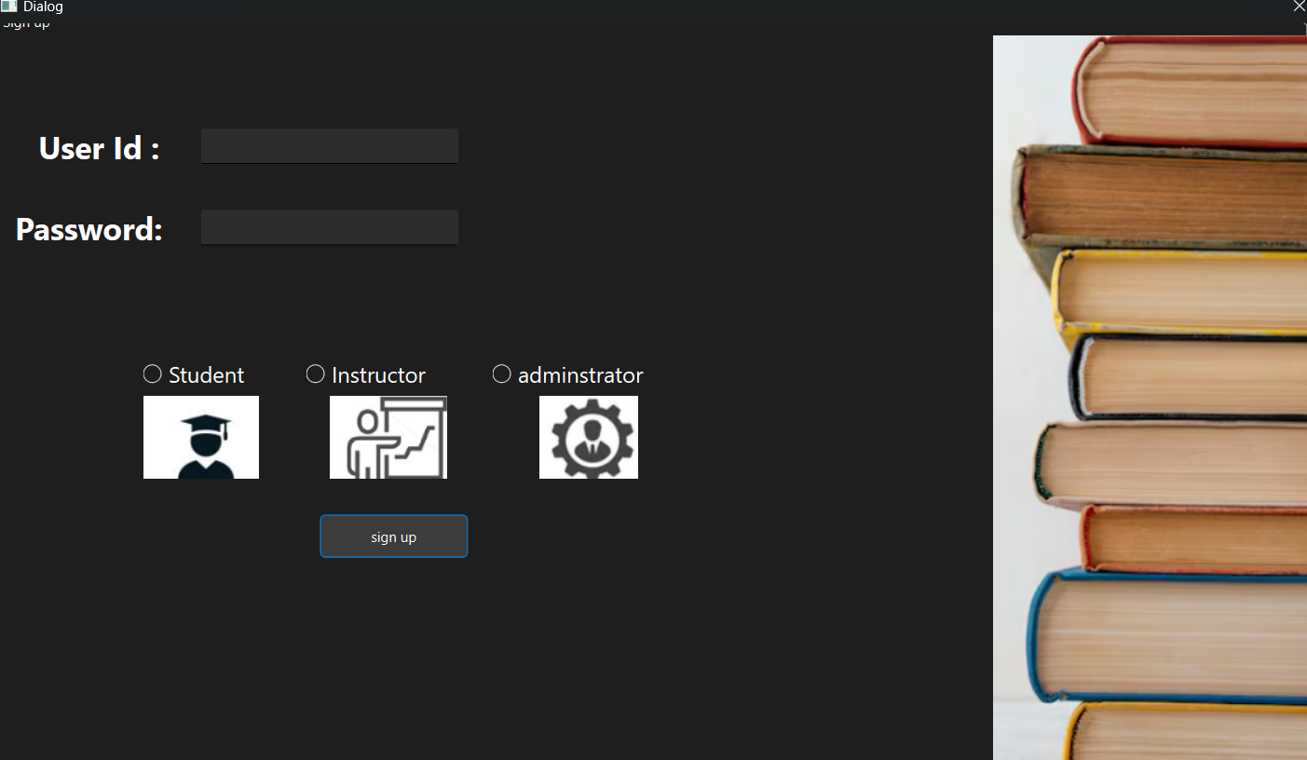
SIGN UP
Firstly, when you open the app you will need to sign up with id and password and choose if you are student, instructor or adminstrator.

Slide 6
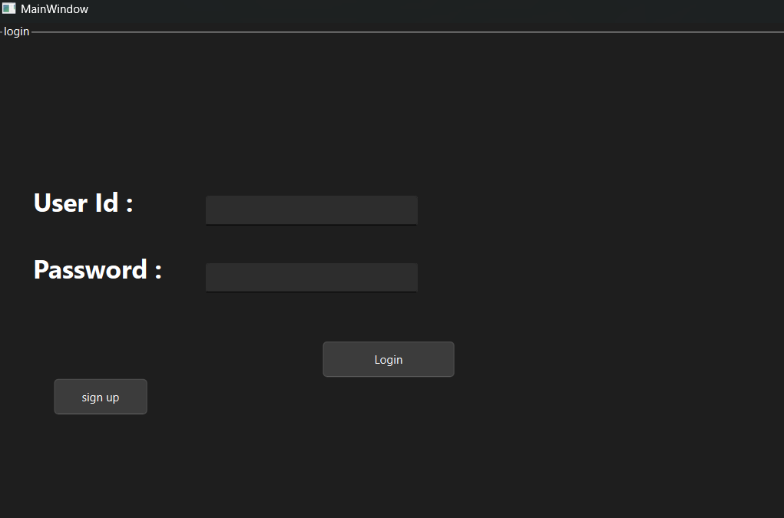
LOGIN
You can’t log in without signing up first.

Slide 7
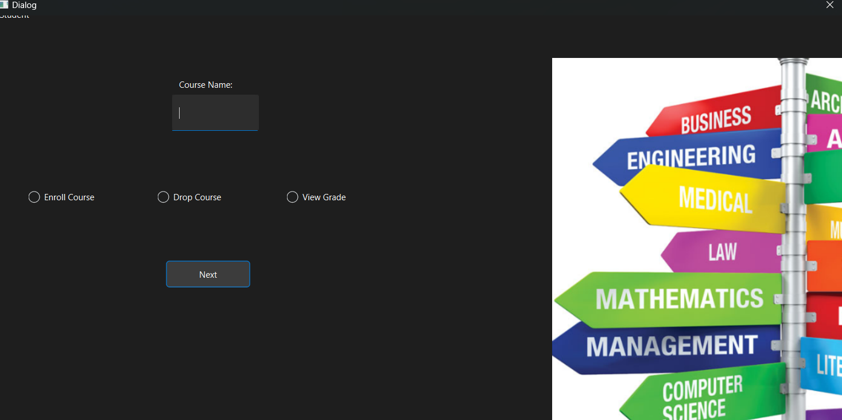
STUDENT
When you sign up as a student, then log in, you will have three options: to add a course to your schedule, to drop or remove a course, or to view a course grade.

Slide 8
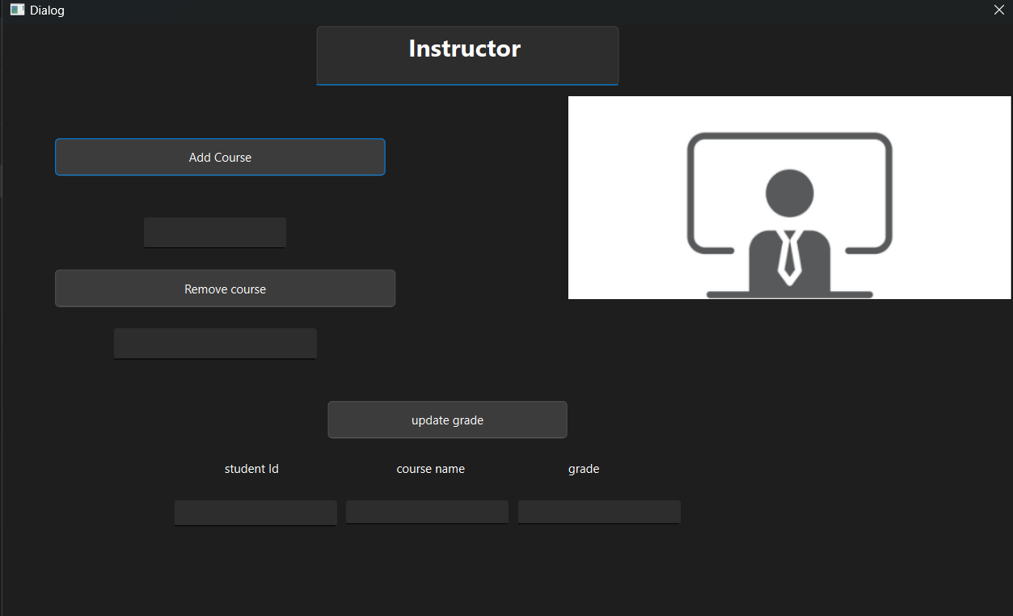
INSTRUCTOR
When you sign up as an instructor, then log in, you will have three options: to add a course, to remove a course, or to update a student's grade.

Slide 9
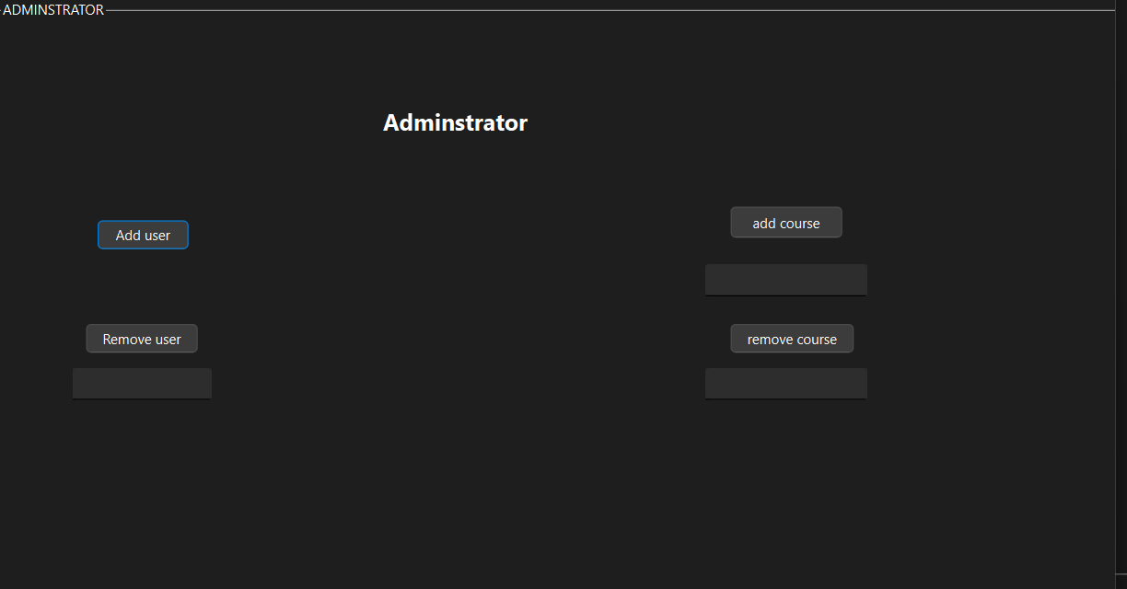
ADMINSTRATOR
When you sign up as an administrator, then log in, you will have three options: to add or remove a course, to add or remove a user, or to manage user accounts.

Slide 10
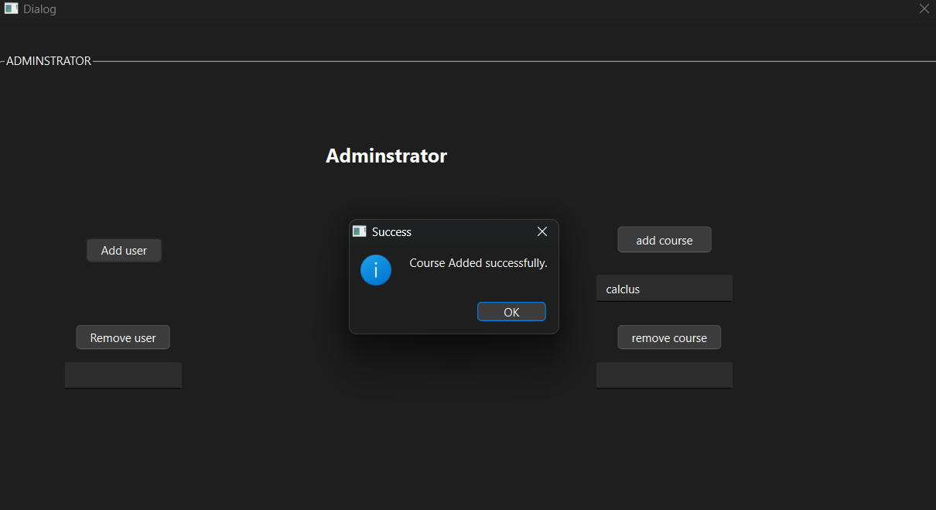
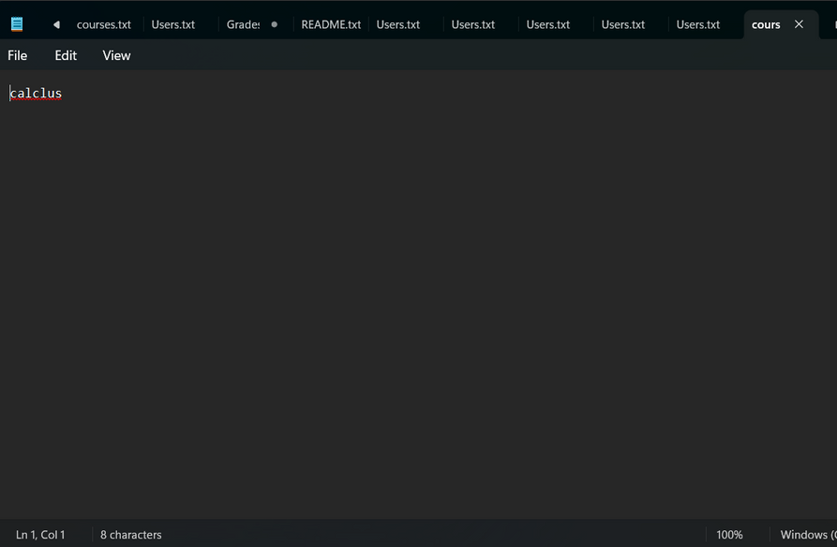
FILES
we used files to add users when signing up the user added his id, password and his rule if he is student, instructor or administrator. also in the courses to add or remove a course.

Slide 11
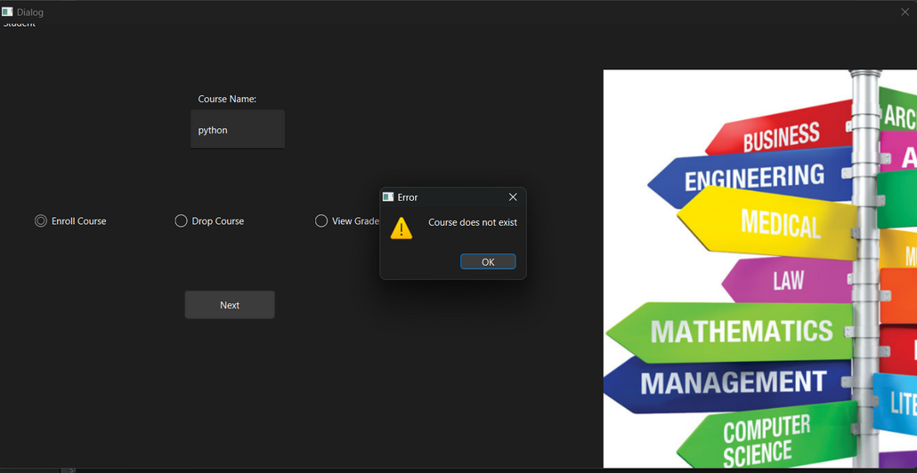
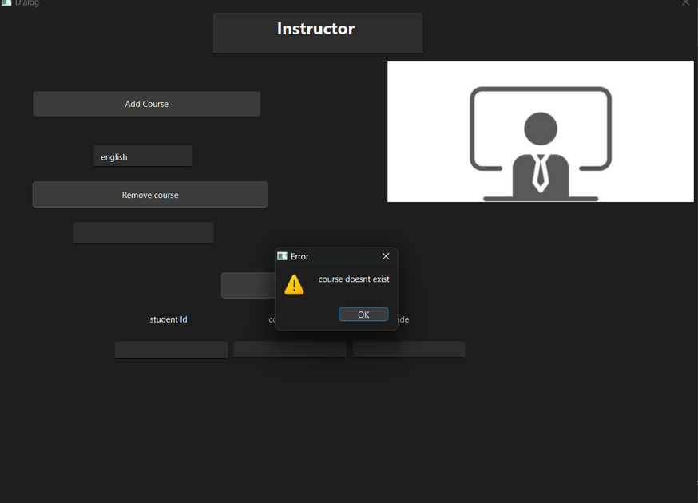
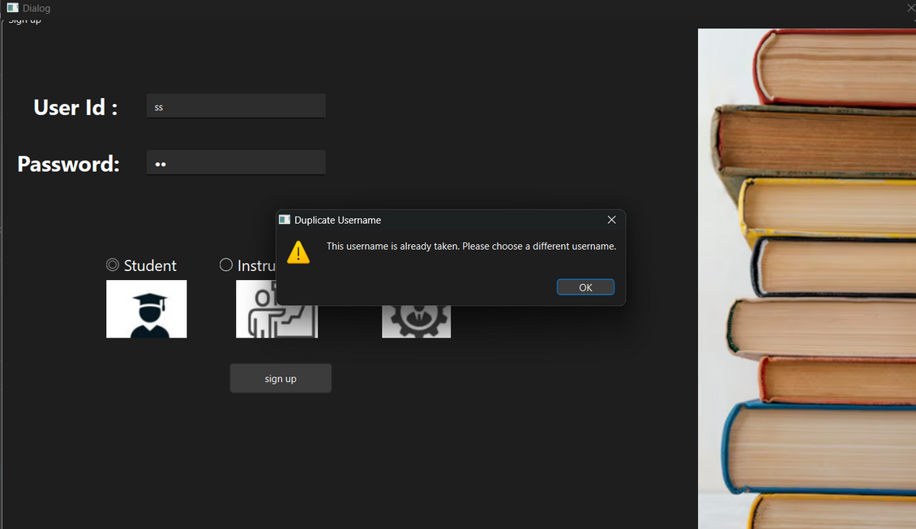
ERROR HANDLING
We tried to handle every single logical error we found.

Slide 12
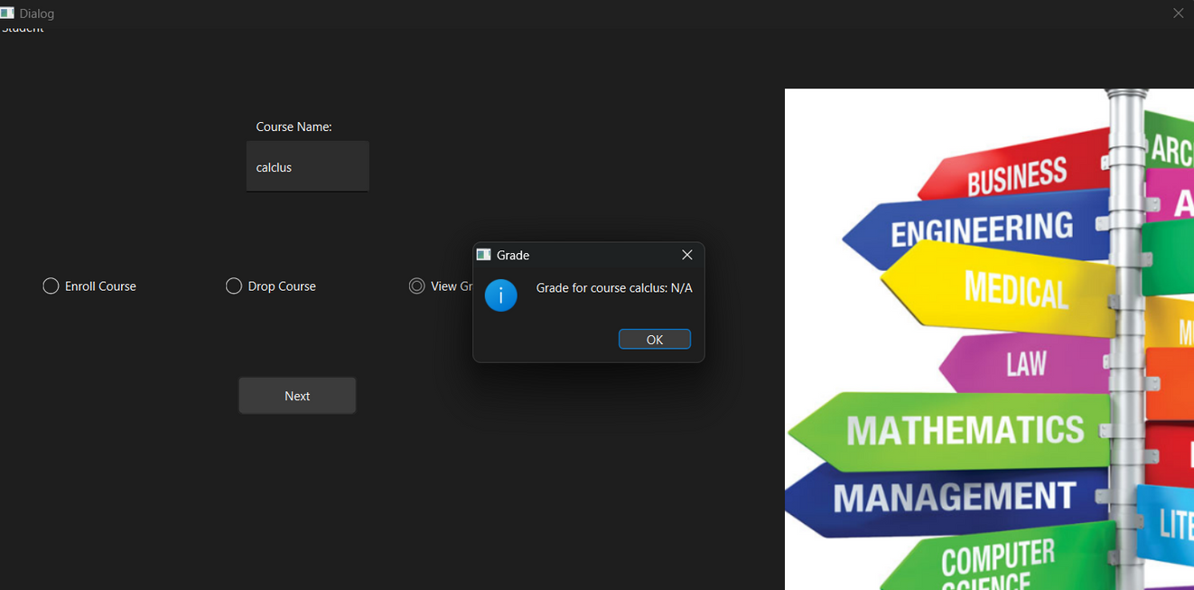
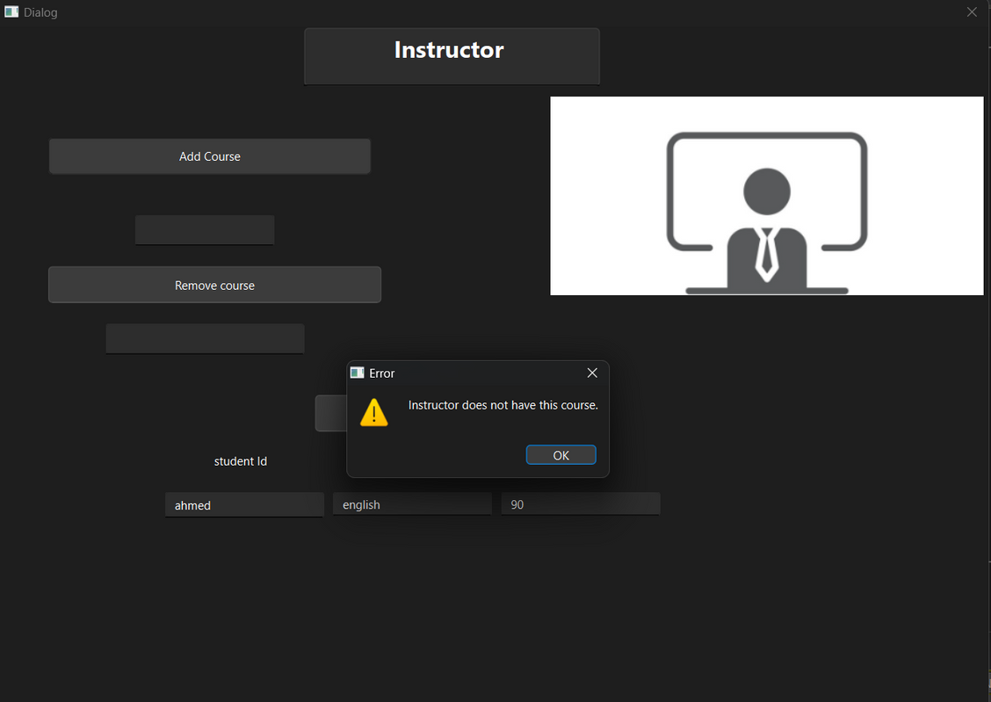
MORE ERROR HANDLING

Slide 13
THANK YOU

